Slide 1




HoGS: Unified Near and Far Object Reconstruction via Homogeneous Gaussian Splatting
(CVPR 2025)
Xinpeng LIU^{1*} Zeyi HUANG^{1*} Fumio OKURA¹ Yasuyuki MATSUSHITA^{1,2}
¹The University of Osaka, ²Microsoft Research Asia - Tokyo (*: equal contribution)

Slide 2
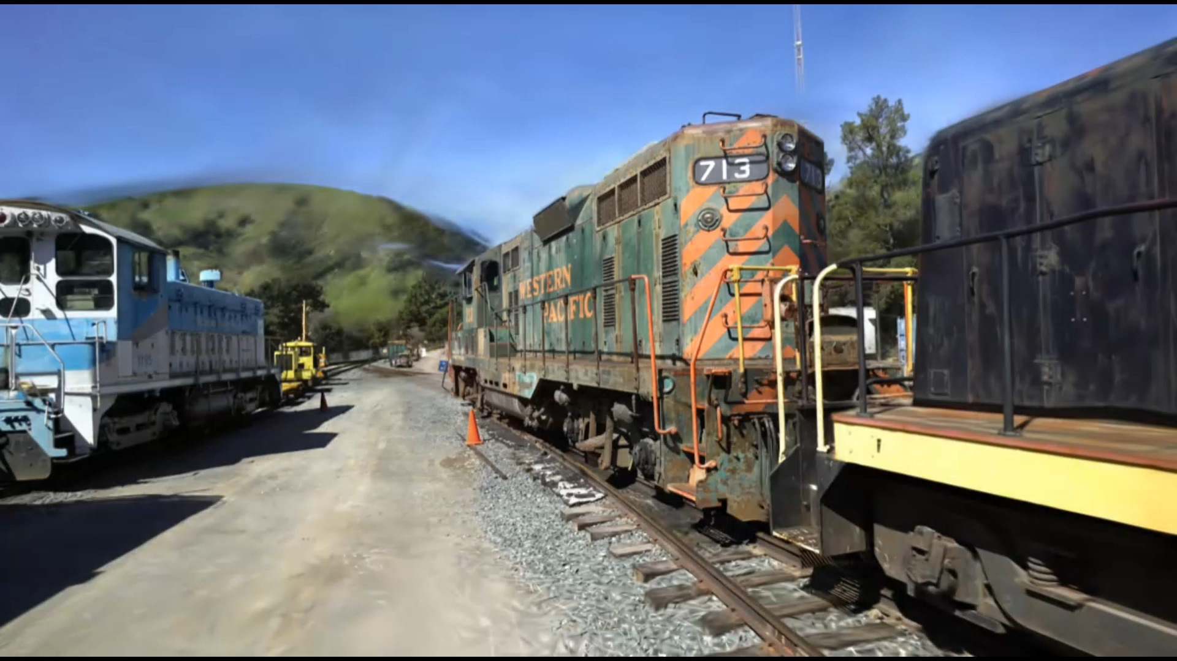
3D Gaussian Splatting (3DGS)
A powerful representation for 3D scenes:
High rendering quality
Fast training time
Real-time rendering performance
Image plane
Camera

Slide 3
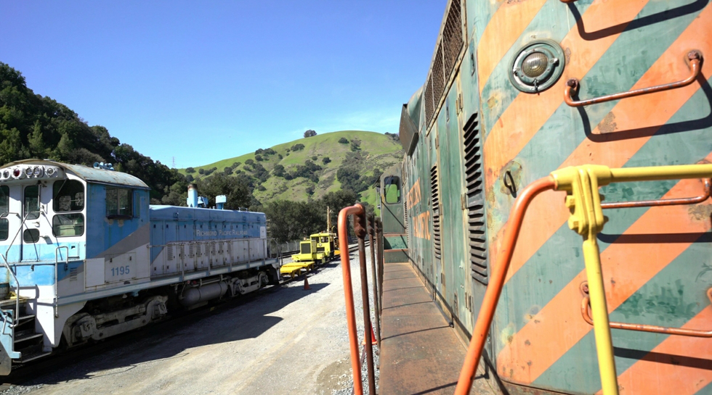
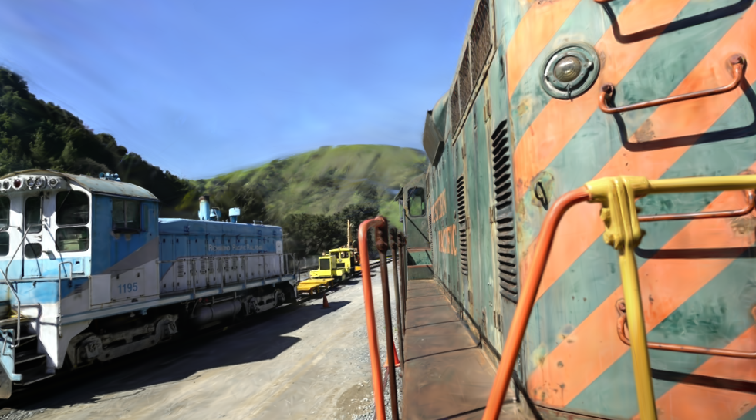
3D Gaussian Splatting (3DGS)
Difficult to represent distant scene geometry accurately
Unfaithful background rendering, especially under novel views
Reduced quality in modeling unbounded scenes
Ground Truth
3DGS

Slide 4
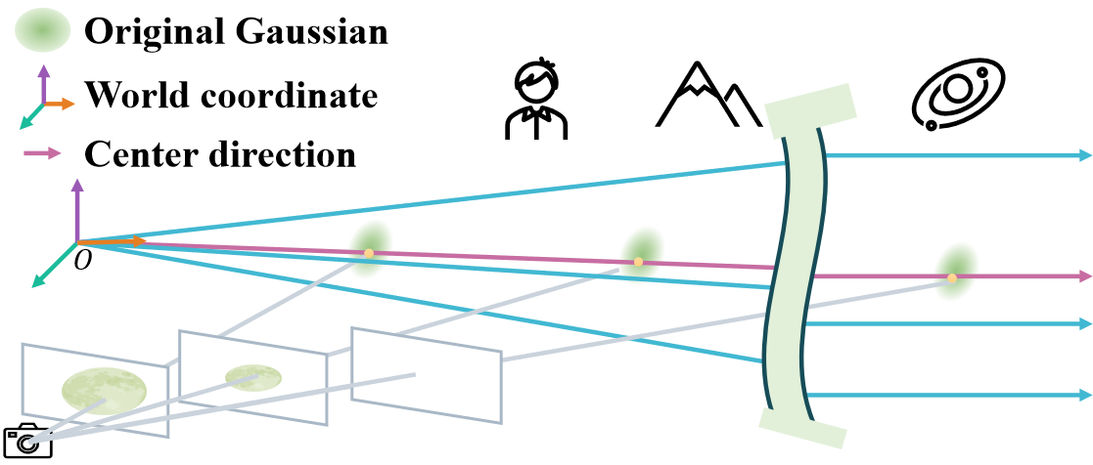
Why 3DGS struggles with distant objects?
In 3DGS, each Gaussian’s position is represented with Cartesian coordinates, which are inefficient for optimizing objects at large distances.
The change in position affect projected size, making it hard to preserve appearance when moving Gaussians away from the camera.

Slide 5
Why 3DGS struggles with distant objects?
In 3DGS, each Gaussian’s position is represented with Cartesian coordinates, which are inefficient for optimizing objects at large distances.
The change in position affect projected size, making it hard to preserve appearance when moving Gaussians away from the camera.
We propose a simple modification to Gaussian Splatting, providing a unified and faithful representation for both near and distant objects!

Slide 6
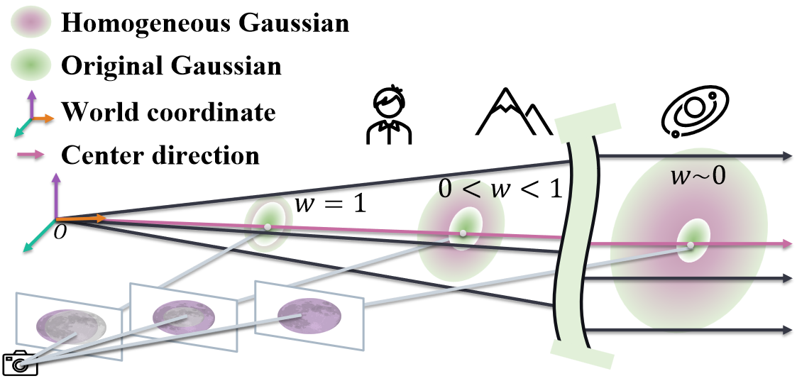
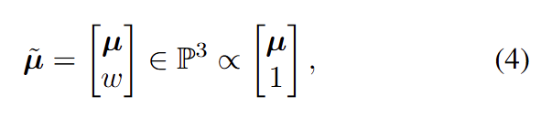
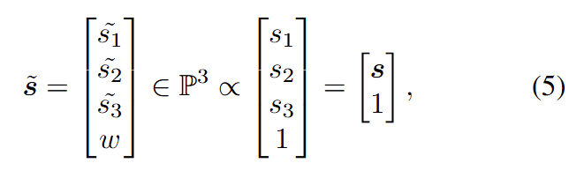
Homogeneous Gaussian Splatting (HoGS)
Reparameterize the positions and scales of Gaussian primitives:
Homogeneous mean
Homogeneous scales
Visualization of Homogeneous Gaussians

Slide 7
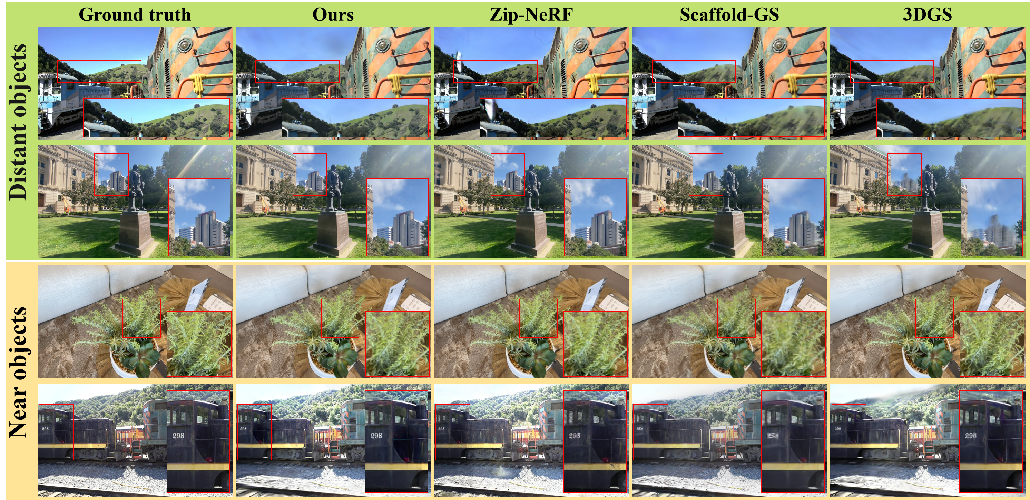
Visual Comparisons

Slide 8
Quantitative Analysis
 | Method / Metric | Mip-NeRF 360 |  |  | Tanks&Temples |  |  | DL3DV-10K Benchmark
 |  | SSIM ↑ | PSNR ↑ | LPIPS ↓ | SSIM ↑ | PSNR ↑ | LPIPS ↓ | SSIM ↑ | PSNR ↑ | LPIPS ↓
NeRF-based | INGP | 0.699 | 25.59 | 0.331 | 0.745 | 21.92 | 0.305 | 0.816 | 26.38 | 0.235
 | Mip-NeRF 360 | 0.792 | 27.69 | 0.237 | 0.763 | 22.23 | 0.255 | 0.872 | 28.70 | 0.152
 | Zip-NeRF | 0.829 | 28.56 | 0.187 | 0.840 | 23.64 | 0.151 | 0.930 | 30.91 | 0.084
3DGS-based | 3DGS (50K iter) | 0.821 | 27.65 | 0.212 | 0.845 | 23.83 | 0.183 | 0.900 | 28.47 | 0.143
 | Scaffold-GS (50K iter) | 0.825 | 28.08 | 0.206 | 0.854 | 24.31 | 0.169 | 0.902 | 29.11 | 0.137
 | Ours (50K iter) | 0.828 | 27.92 | 0.194 | 0.858 | 24.27 | 0.166 | 0.919 | 29.93 | 0.114

Slide 9
Conclusion
We propose HoGS, a novel method adopting homogeneous coordinates to represent positions and scales of 3DGS for realistic and real-time rendering of both near and far objects.
Our method achieves state-of-the-art novel view synthesis results compared to other implicit and explicit representations.

Slide 10
Thank you for your time
huang.zeyi@ist.osaka-u.ac.jp

